Slide 1
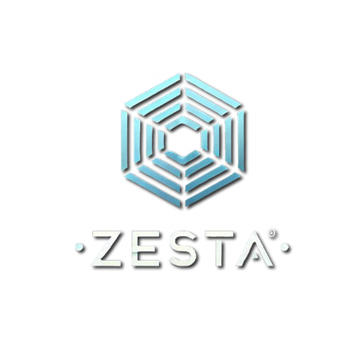


Blinkit
Churn Analysis

Slide 2
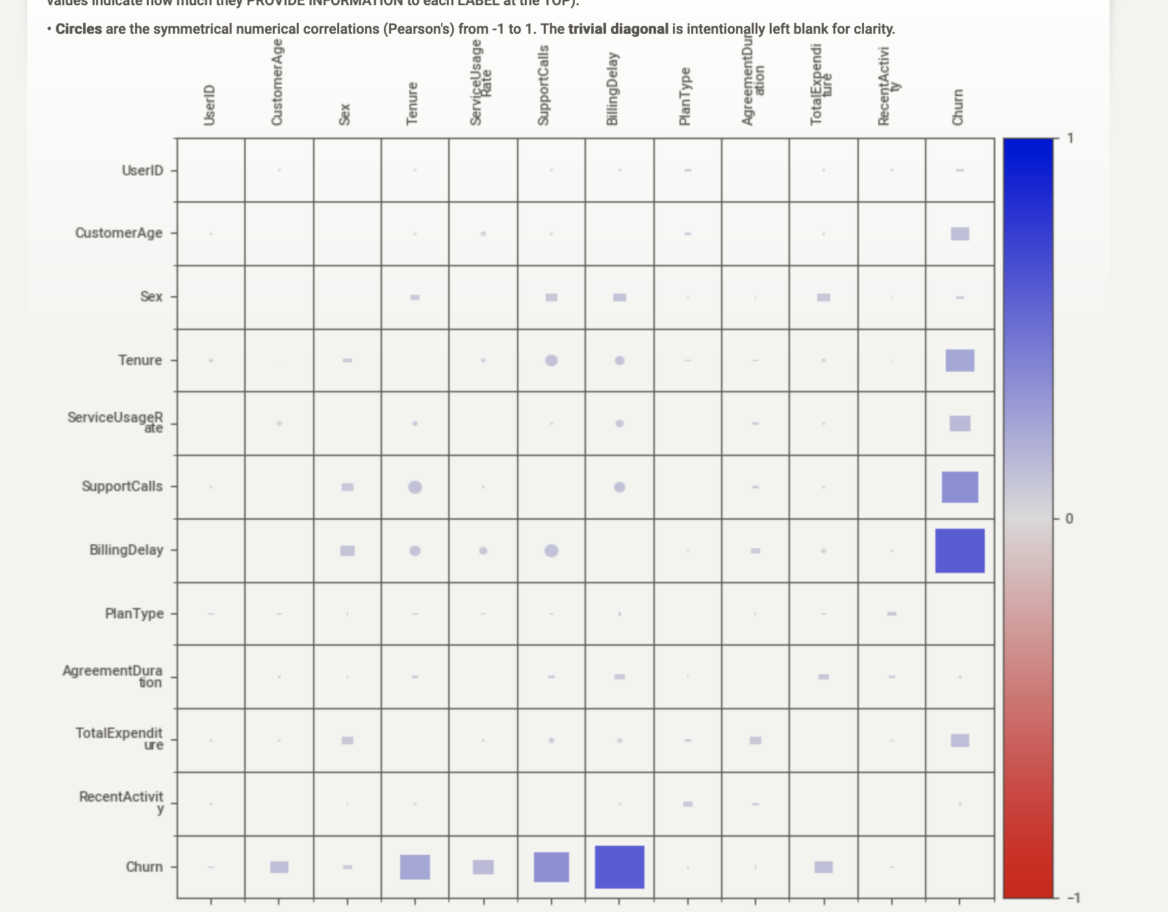
1.1 General All-User Encompassing Strategy for Churn Reduction
Key Findings:
Our predictive model highlights that Billing Delay is the most significant contributor to churn, followed by Support Calls, Sex (Female), Service Usage Rate, Tenure and Customer Age.
"These variables provide a starting point for an effective strategy by understanding how variables affect the Churn Rate of Blinkit
It can be seen from the correlation matrix that there are correlations between: SupportCalls & Churn and BillingDelay & Churn. We see positive correlations with these variables.
We need to focus our efforts towards these variables and implement the following strategy for All Users.
Streamline and Proactive Billing:
Why?: Excessive or inconsistent billing delays cause user dissatisfaction and contribute to churn.
How?: - Provide transparent and itemized billing bifurcation to reduce delays due unexpected charges.
- Offer a payment option for especially customers with high tenure with a BNPL(buy-now pay later) or a postpaid invoice-based service to significantly reduce churn.

Slide 3
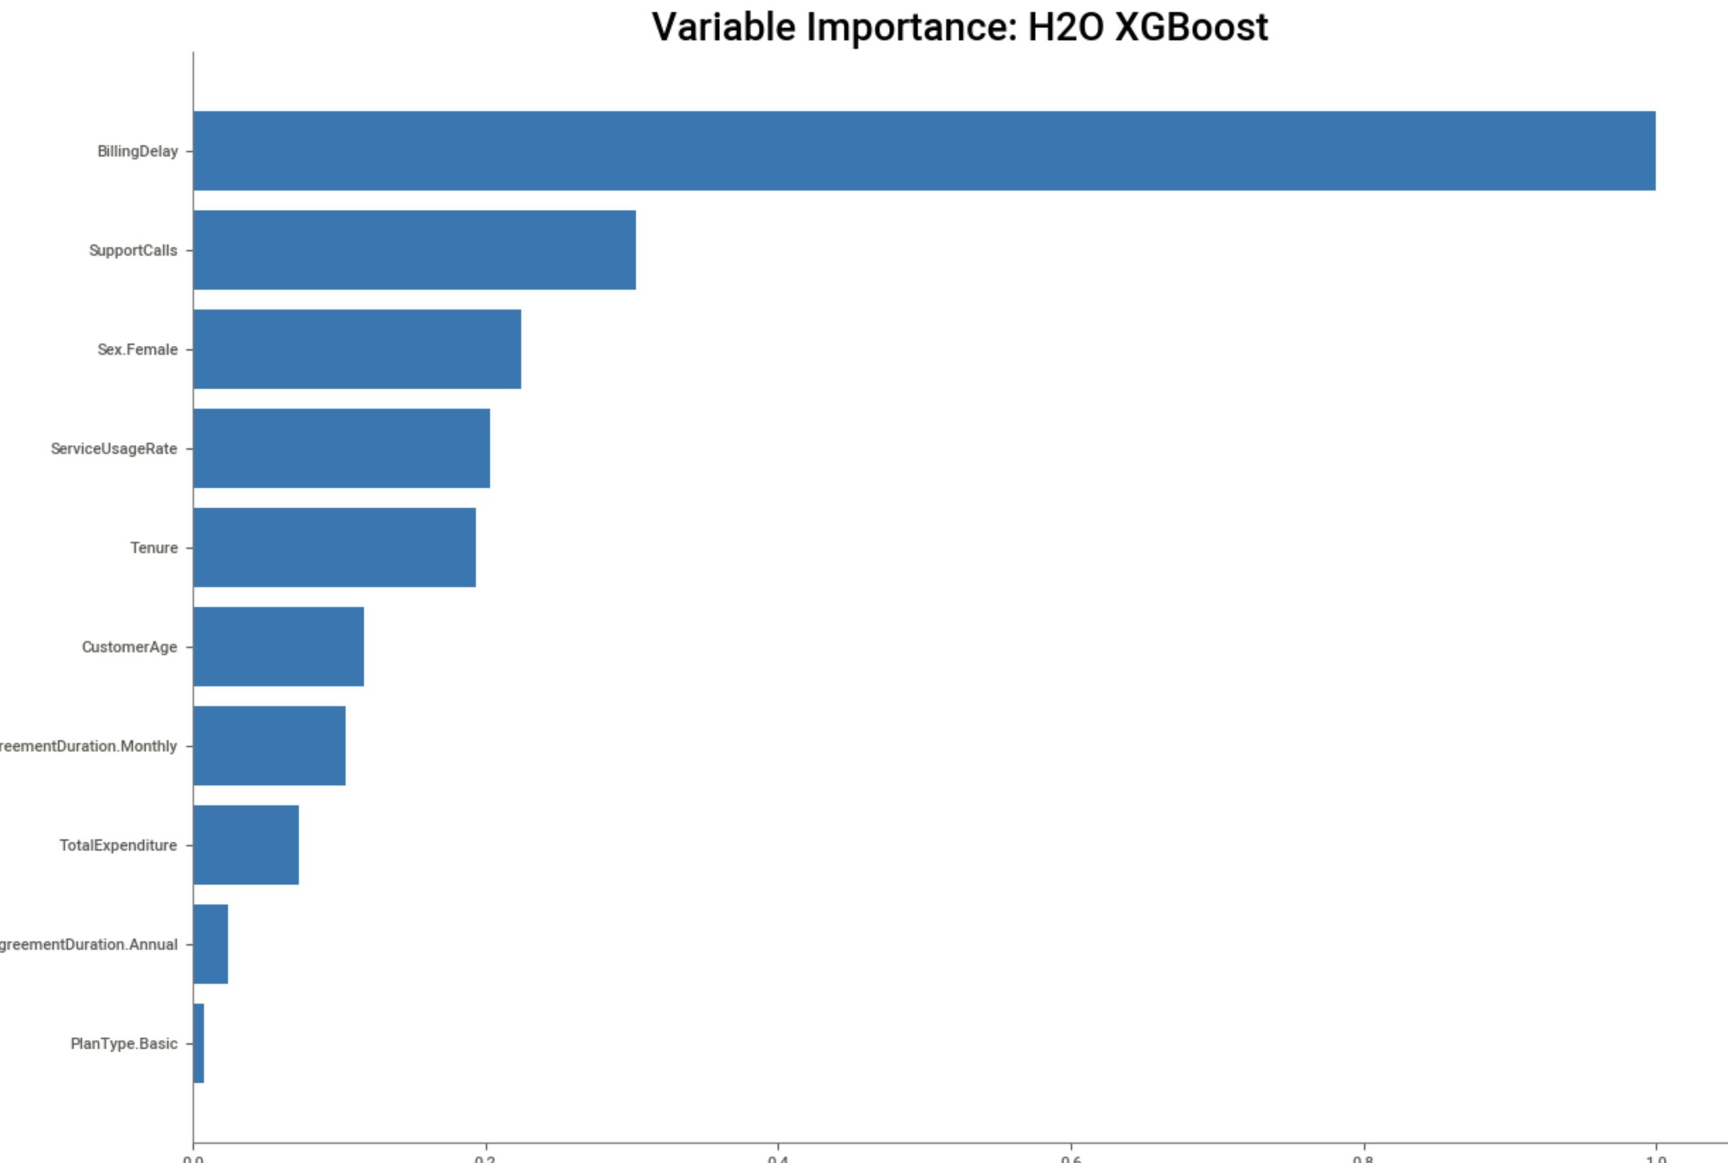
1.2 General All-User Encompassing Strategy for Churn Reduction
2. Enhance Customer Support:
Why?: High support call volumes reflect user frustration and issues requiring assistance.
How?: - Reduce dependencies on Support Calls by creating a strong and informative help center
Leverage modern AI multi-modal voice models to cater customer grievances at scale & that too in regional languages in a cost-effective on-premise deployment model.
3. Female Users:
Why?: The XGBoost/DeepLearning model indicates female users have a higher tendency to churn, it is imperative to make sure female user experience is optimal.
How? :
SKU : Female-centric SKU’s per dark store must be increased to cater to the respective audience better.
UX Testing : Actively solicit feedback on the app from female users to address any unique pain points.
Plan Tier: A special plan tier cheaper & need-centric for women is required

Slide 4
2. Per-User Telemetry-Based Predictive Preventive Measures
Why?
While a general strategy addresses broad issues, a personalized approach is vital for targeted churn prevention. By leveraging telemetry data, Blinkit can identify at-risk users and deploy preventative measures."
High Billing Delay User:
Identification "User has a history of frequent or excessive billing delays."
Preventive Measures:
"Real-Time Billing Notifications: Send instant alerts about charges and payment confirmations"
"Offer flexible payment plans or credits."
"Provide a dedicated support channel for immediate resolution of billing disputes."
2. High Support Calls User:
Identification: "Users with high support call frequency are prone to churn due to negative experiences."
Preventive Measures:
"Proactive support: Initiate contact to resolve ongoing issues"
"Personalized Help: Offer tutorials on app usage specific to problems they have faced"
"Feedback Loop: Implement a system to address feedback on user experience"
3. Low Usage / High Tenure Users:
Identification: "Users with long tenure who have suddenly dropped their service usage are a high risk of churn."
Preventive Measures:
"Personalized recommendations: Push customized offers based on past purchase history"
"Re-engagement campaigns: Send reminders to users to return to Blinkit"
"Exclusive benefits: Offer exclusive perks for long-term loyalty."
Telemetry Data Utilization
"Our analysis highlights the importance of ServiceUsageRate, Tenure, CustomerAge, and TotalExpenditure, variables that can be tracked using telemetry data. A Predictive model using these variables can help identify users at risk of churning."
"The dataset indicates that RecentActivity is not a strong predictor but can provide some indication of risk."
"Data points are indicative of a User's risk of churning."

